Slide 1

School Based TBI Teams
Melaney Grenz, M.S,CCC-SLP

Slide 2
Disclosures
I have no financial disclosures:-)

Slide 3


My Background
B.A, Communication Disorders, Minot State U
B.Sc, Elementary Education and Education of the Deaf, Minot State U
M.Sc, Communication Disorders, U of O

Slide 4
Professional Career
SLP, TAG Coordinator, 504 Coordinator in SPS
-TOSA (Special Ed. Dept.)-2008-9 (Nine LONG months)
PRN work in SNF’s, Hospitals since 1999
Private Practice since 1999
Oregon TBI Team since 1999 - Now Lane Co. Liaison
Lane Co. Concussion Management Team in junction with U of O, Slocum Medical Center, and Lane County public schools

Slide 5
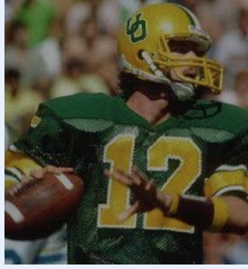

MEDIA ATTENTION RE: TBI
** Gronkowski - 20 concussions in his career
** Chris Miller sustained 8 concussions

Slide 6
Media Attention (Continued)
In the state of Oregon:
1.) Max’s Law (2009 OR Senate Bill 348))
2.) Jenna’s Law (2013 OR Senate Bill 721)
I love sports - play them safely
Broad response in athletics ⚫ Athletic trainer presence growing ⚫ Education for coaches ⚫ Education for parents/students ⚫ Education for officials ⚫ Equipment changes ⚫ Player safety programs ⚫ Creation of policies and procedures

Slide 7
Pre-Test TBI 101 (True or False)
TBI is the most prevalent eligibility category in special education in Oregon.
Most students diagnosed with brain injuries receive special education services.
When students return to school after TBI, their level of functioning remains fairly constant over time.
Specific accommodations and accommodations designated for a student rarely change in a given student’s academic career.
Every student who sustains a concussion, TBI, ABI needs an IEP.
All states require a medical diagnosis/medical statement documenting the injury before an IEP, 504 Plan can be initiated.
Most school staff are abundantly aware of TBI.
Athletes who have sustained three or more concussions are more likely to have long-term cognitive issues.
Notes:
True
False
False
False
False
True
False
True

Slide 8
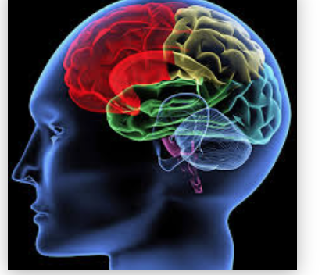
Melissa McCart Studies
How much do educator’s really know about TBI?

Slide 9
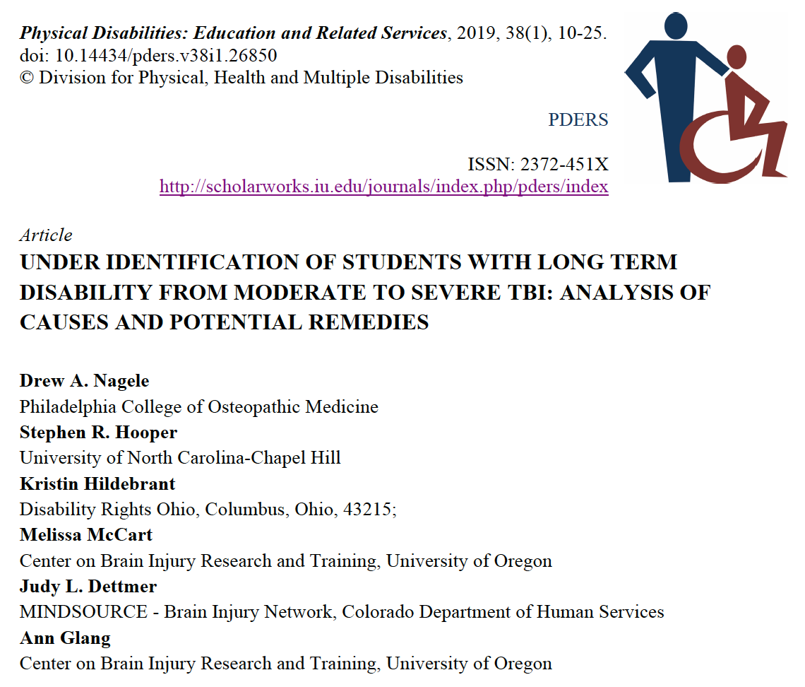

Slide 10
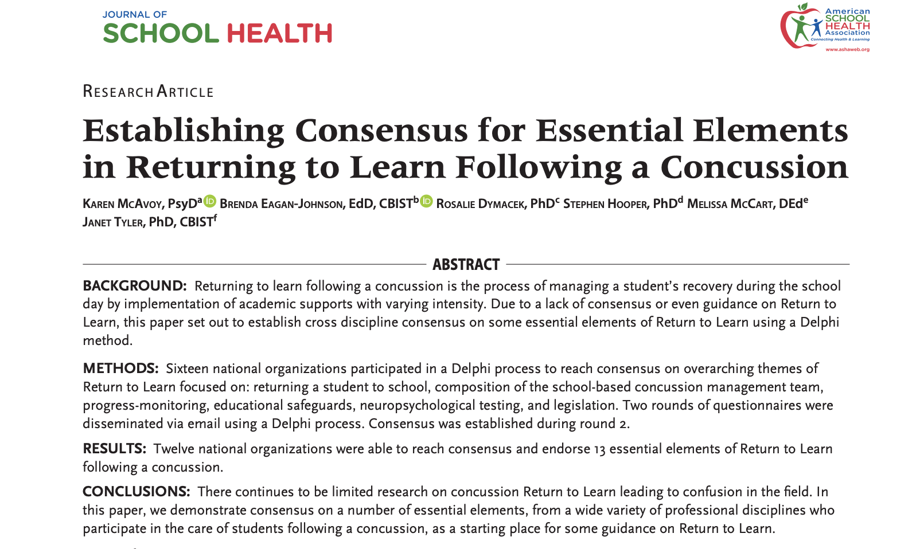

Slide 11
Implications for School Health
Researchers have discovered that some school staff and some medical providers have varying knowledge when it comes to concussion management.
There needs to be a concerted statewide and Department of Education (ODE) endorsed effort to train staff on aspects of RTL (Return to Learn) Concussion Management.

Slide 12

TBI Studies in process at the present time
B-JUST TEAM STUDY (EUROPE AND USA) - incarcerated youth
CDC Studies - on going
cbirt.org - ongoing studies

Slide 13
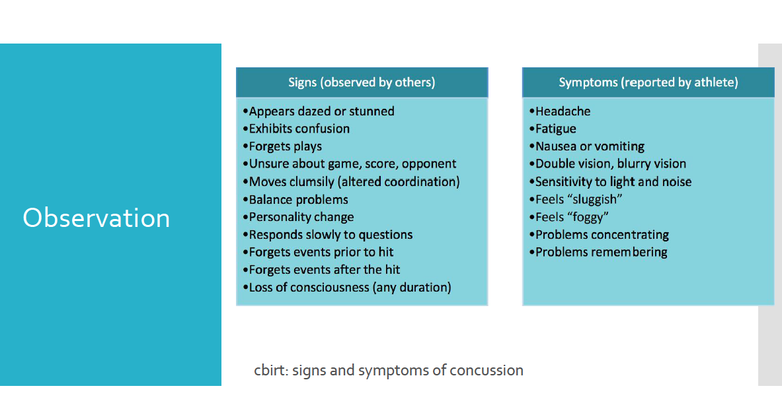
Signs and Symptoms of a Concussion

Slide 14
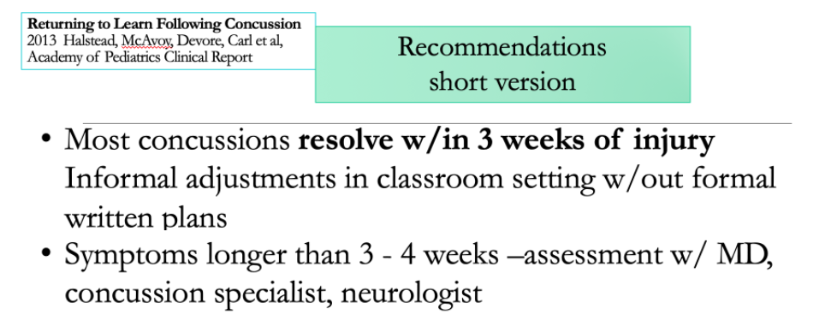

Slide 15
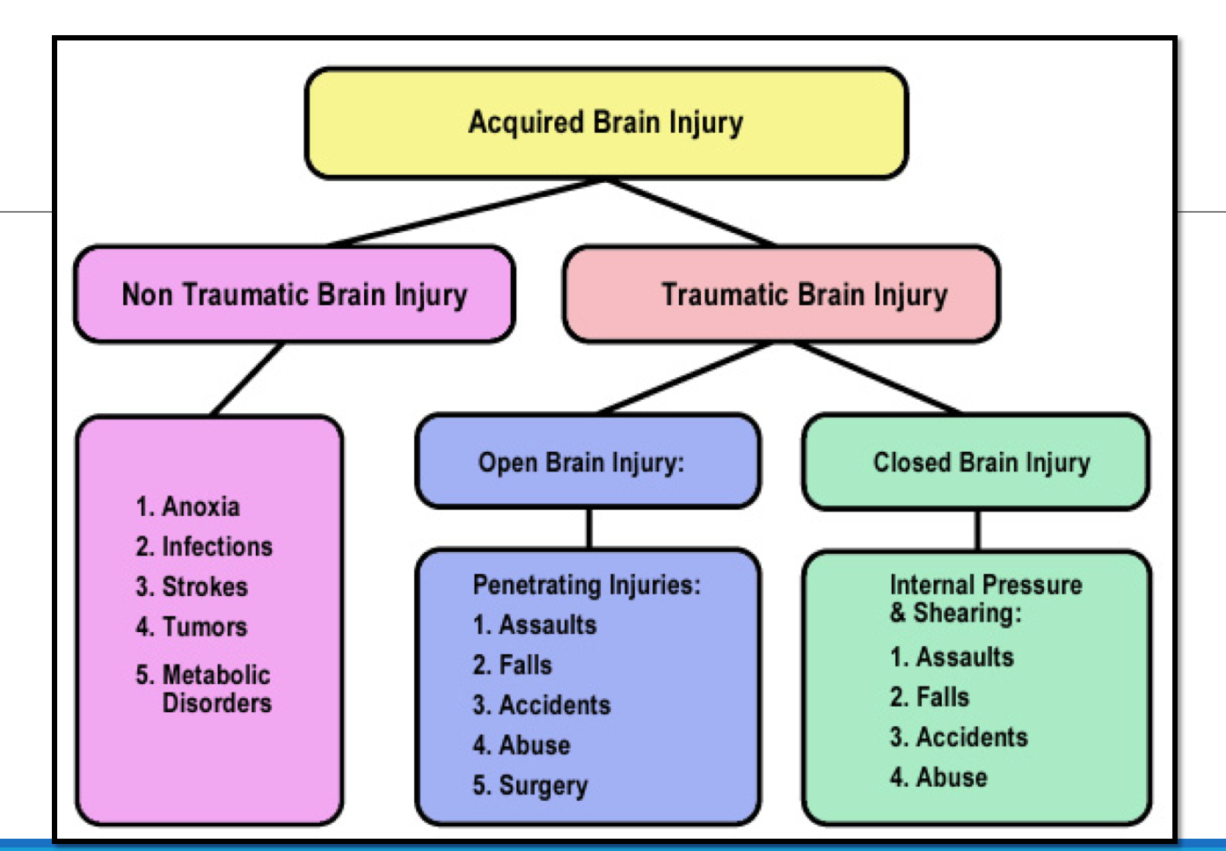
TBI/ABI

Slide 16
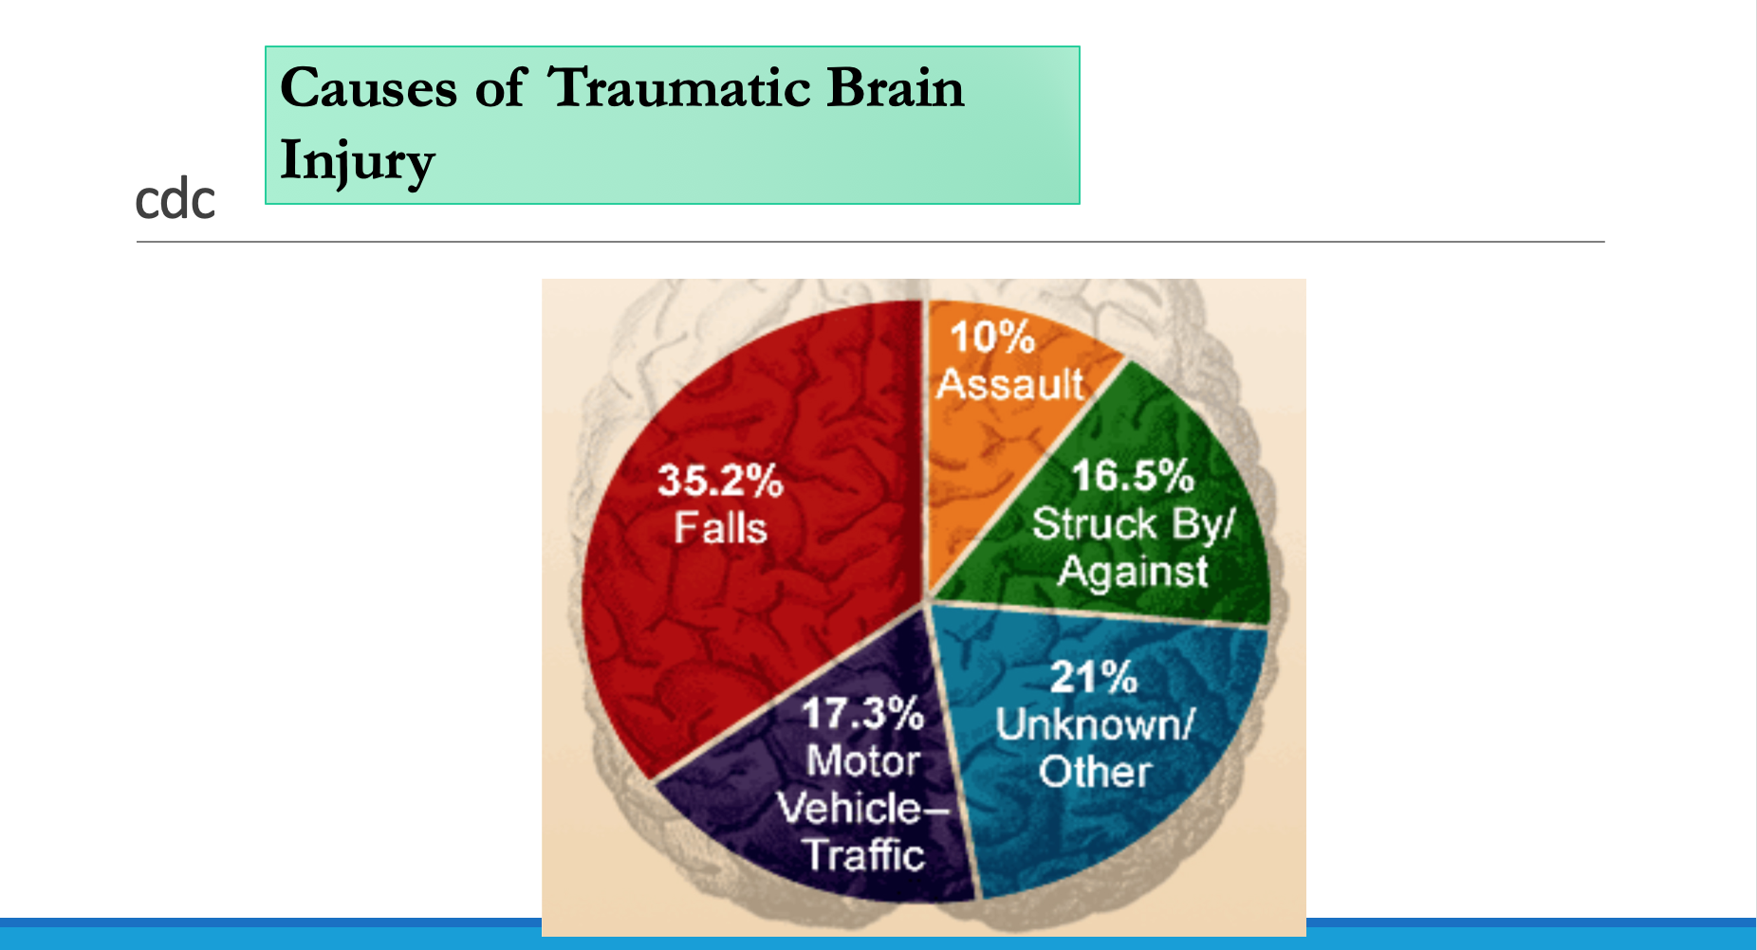

Slide 17
My student sustained a concussion, TBI,ABI now what?”
Run to the crisis- DO NOT sit back… Time is of the essence, and a liability could be looming
Get permission to obtain information (ROI’s) out immediately
Gather records, and prepare to meet with the family
Call in other professionals to help, contact ME, contact cbirt.org

Slide 18
I have the necessary data now what?
-IEP vs. 504 Plan
Short term modifications
Eligibility?

Slide 19
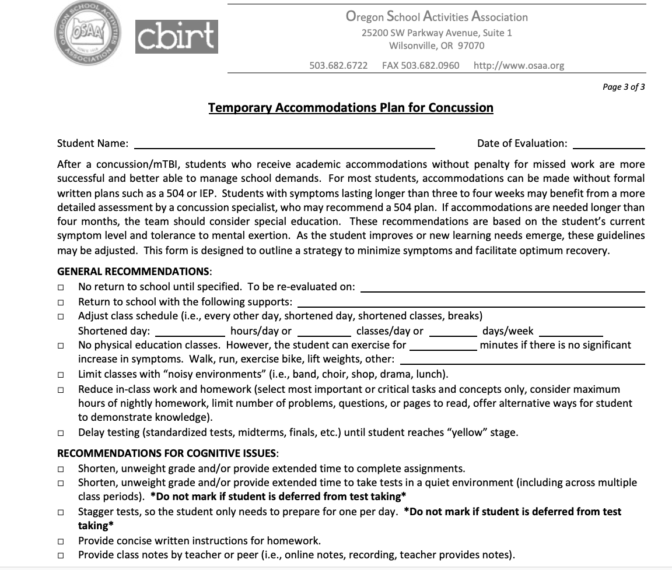
Slocum’s Accommodations-Dr. Koester,Dr. Watson-Stites

Slide 20
IDEA Eligibility
Oregon= 74,034 students aged 6-21 with eligibilities
-260 TBI eligibilities in the entire state of oregon
SPS= 11,000 students - 1700 with eligibilities, and 1 student with a TBI eligibility!!!!
-504’s in Lane Co.=54 (that I am involved in and/or know about)

Slide 21
House Bill 4140
This measure requires ODE to develop a form by August 1, 2021 to use with students diagnosed with a concussion or another brain injury. This form must describe the academic accommodations available to a given student.

Slide 22
Why not just give a student a different eligibility? OHI, CD, SLD???
Greater variability over time and setting
Knowledge of TBI can be lost over time, but effects not lost
Long term need for support, may occur after students no longer eligible under another eligibility
Consequences of TBI may not be recognized as disability

Slide 23
LT Consequences of Incorrect Eligibility
Disability Determination Services benefits
Vocational Rehab Services
Changes in mental health, behaviors at home, school, work, educational attainment over time, college experience (504 Plan, Disability Services)

Slide 24
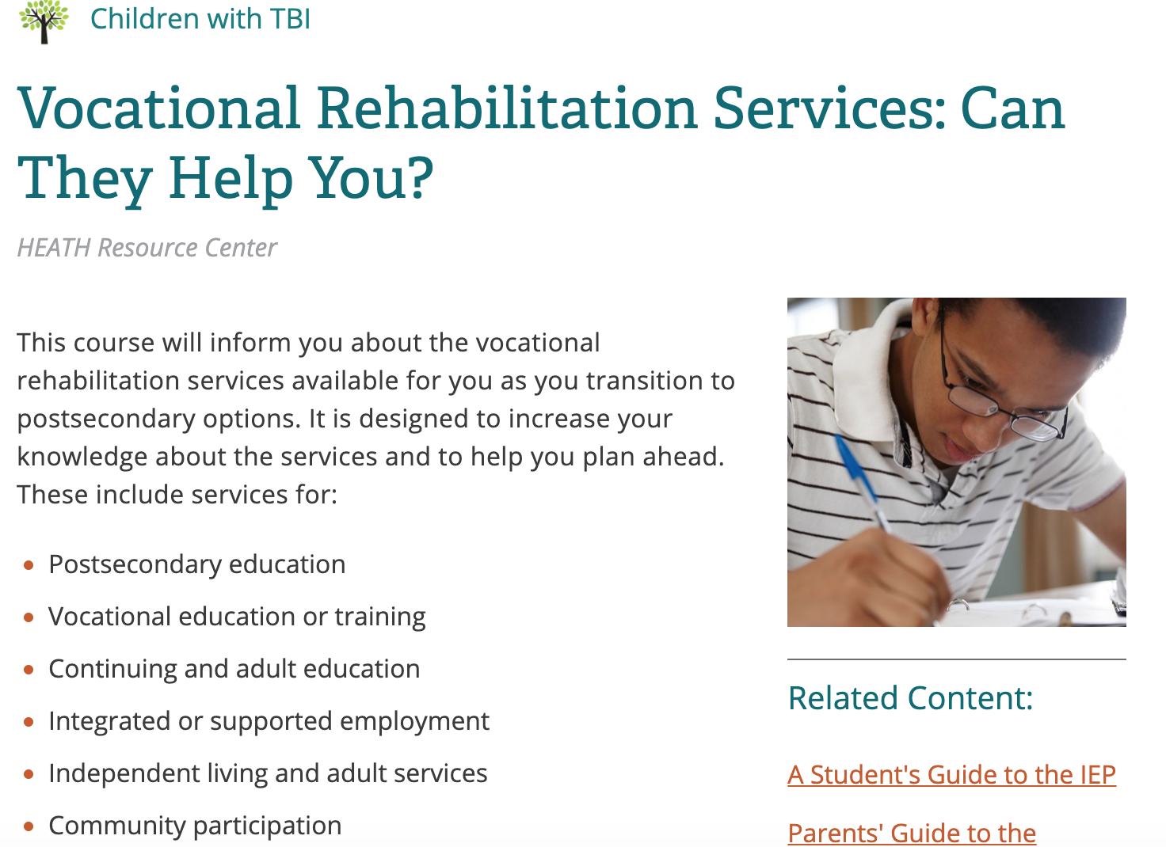

Slide 25
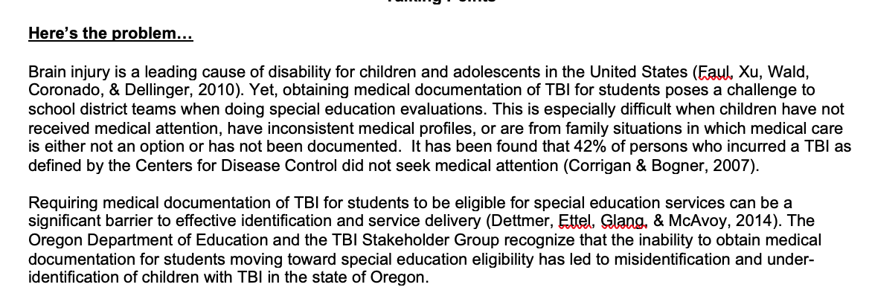
What is a Credible History?

Slide 26
Guided Credible History Interview Process
For cases where medical documentation cannot be obtained
It is a carefully crafted interview used with a reliable and credible source to thoroughly explore a student or family’s report of a possible TBI.
Used in place of a medical or health statement

Slide 27
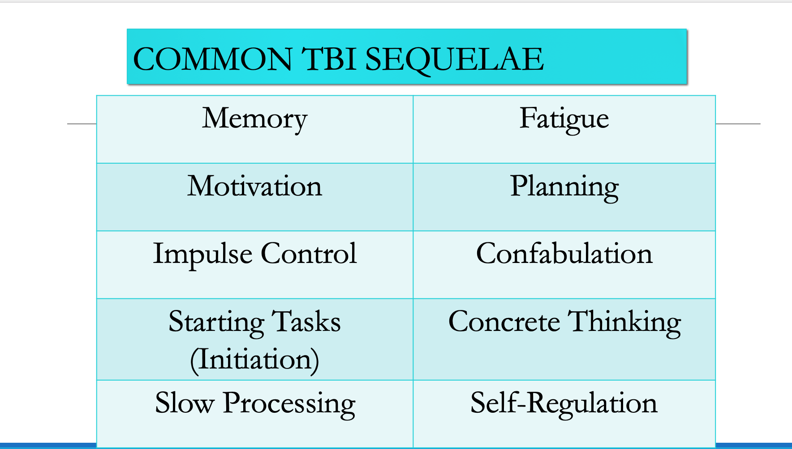

Slide 28
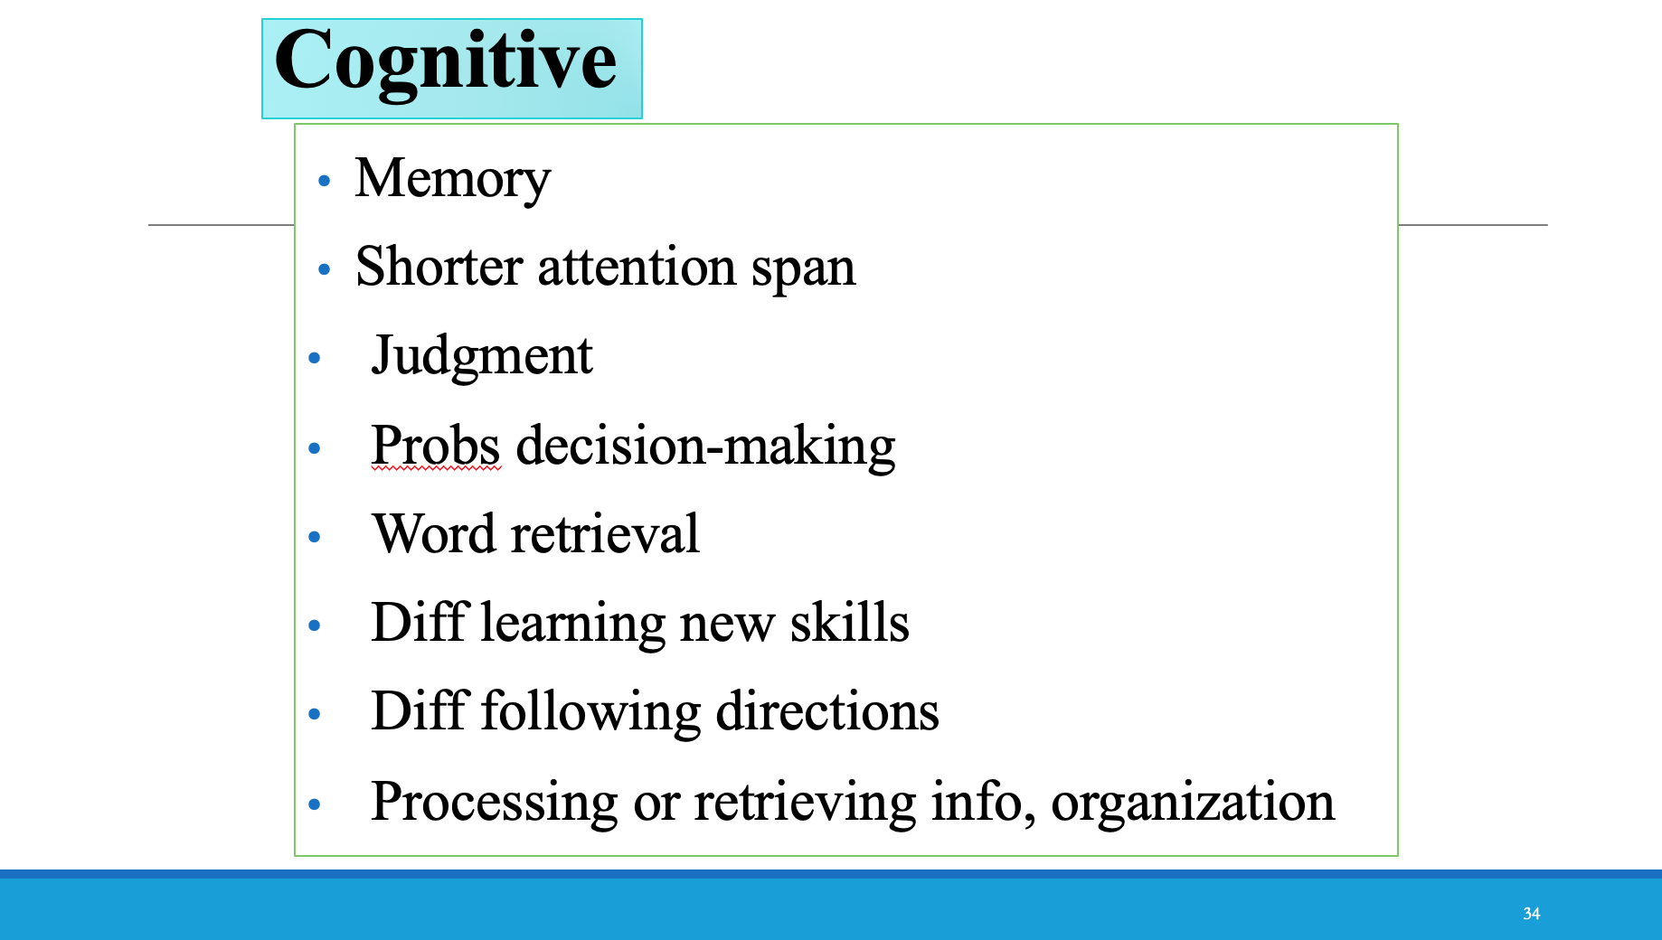

Slide 29
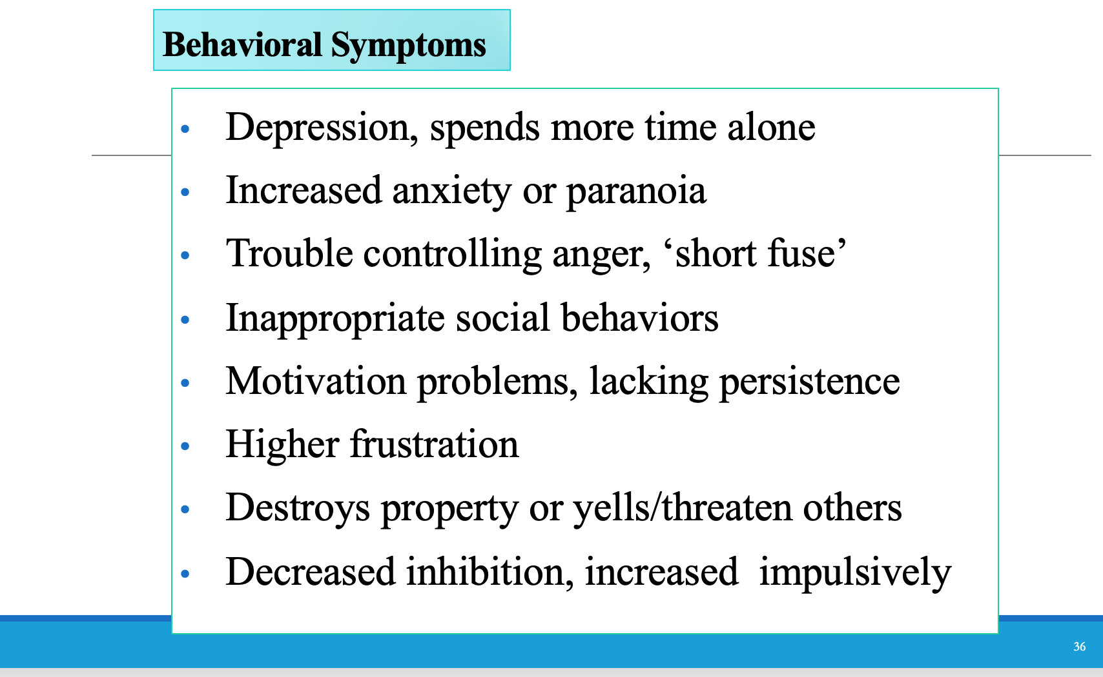

Slide 30
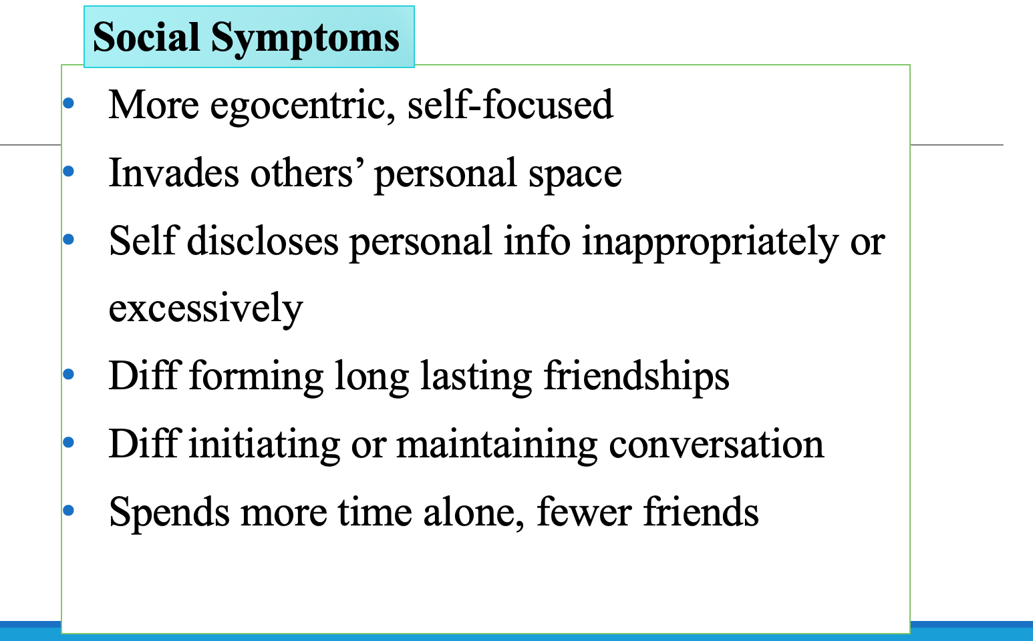

Slide 31
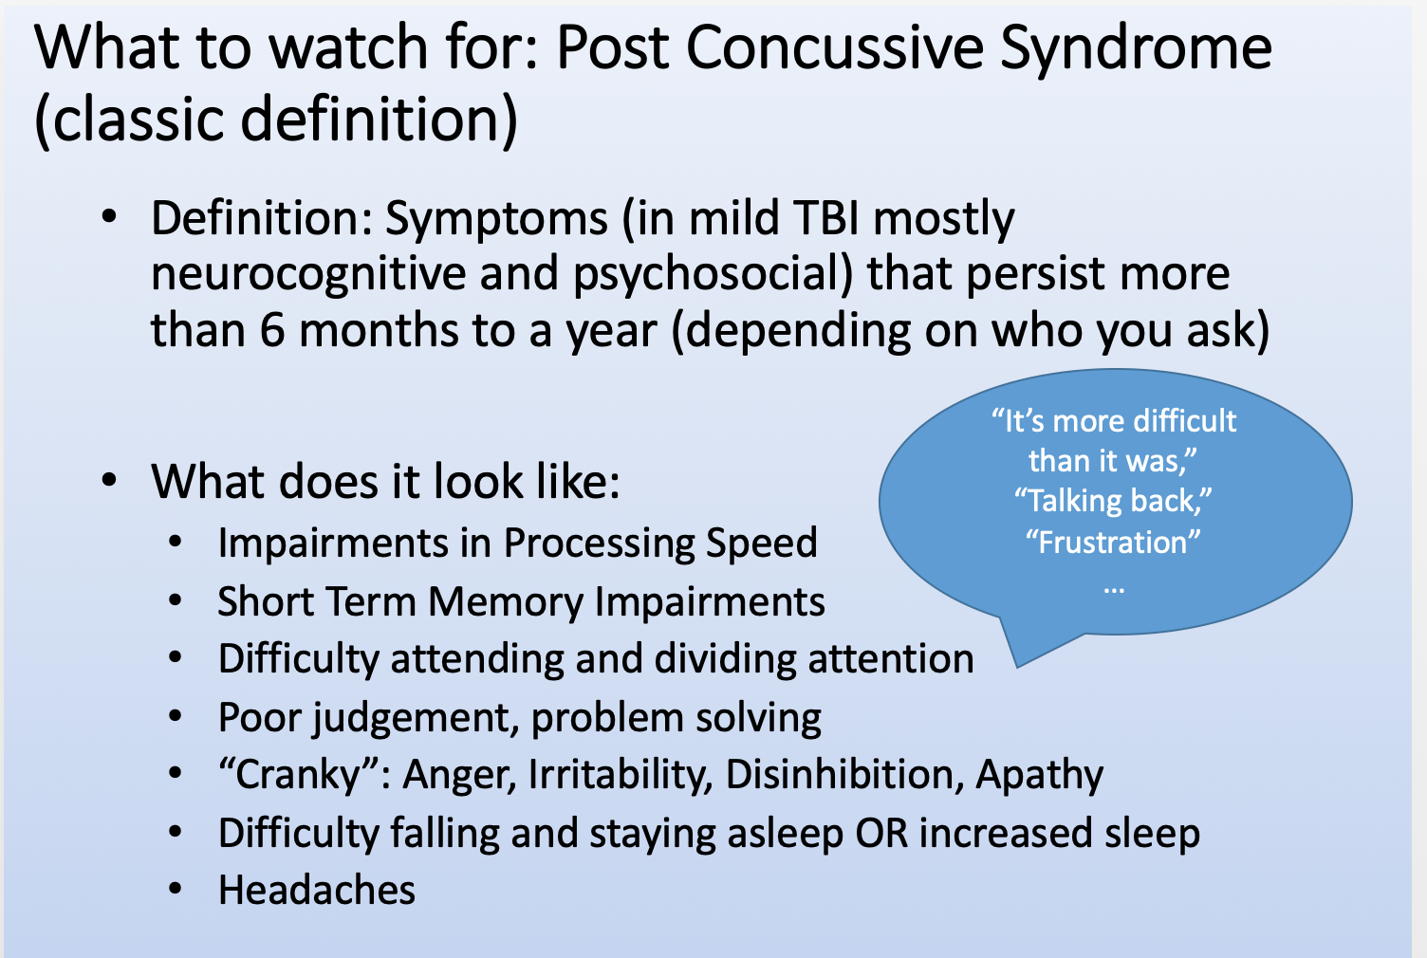

Slide 32
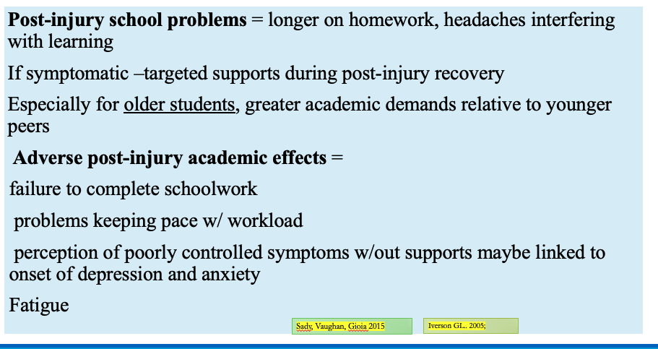

Slide 33
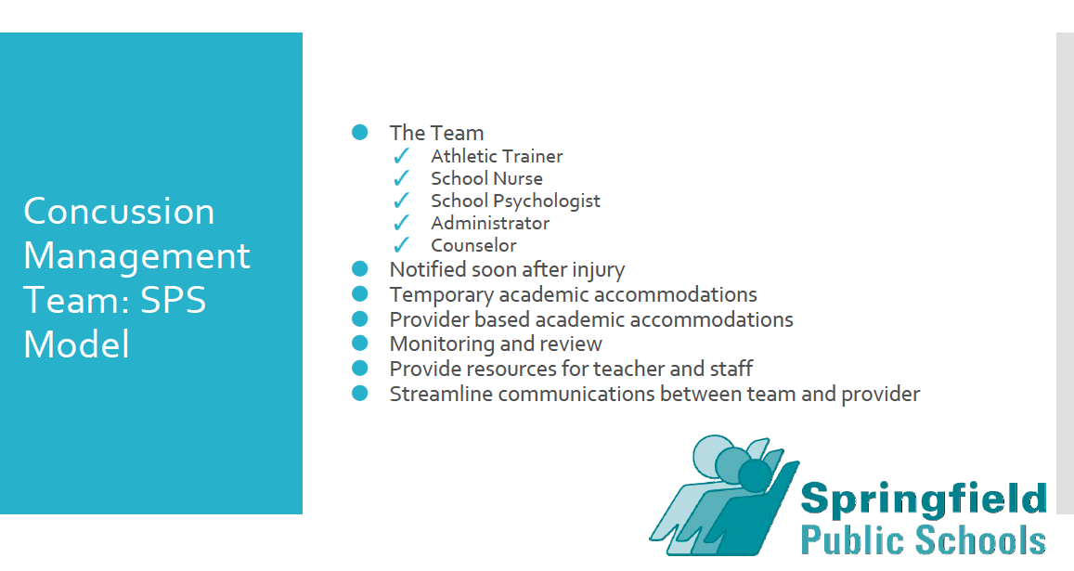

Slide 34
What Does the School Based Team Do?
Screen
Identify
Intervene
Use evidence based practices
Accommodate needs
Monitor and change as needed

Slide 35
Lane Co. Concussion Management Team
Ryann Watson-Stites (Neuropsychologist), Karen Angel (Psychologist,) Jim Wright, McKay Sohlberg, Mick Koester, (Sports Medicine, M.D) Jeff Frank (Pediatric Neurologist), myself
Meet one time month to discuss students that we share - medical and education
We have a close relationship with one goal in mind - RTL and RTP safely
Ryann’s temporary accommodations (previous slide)

Slide 36
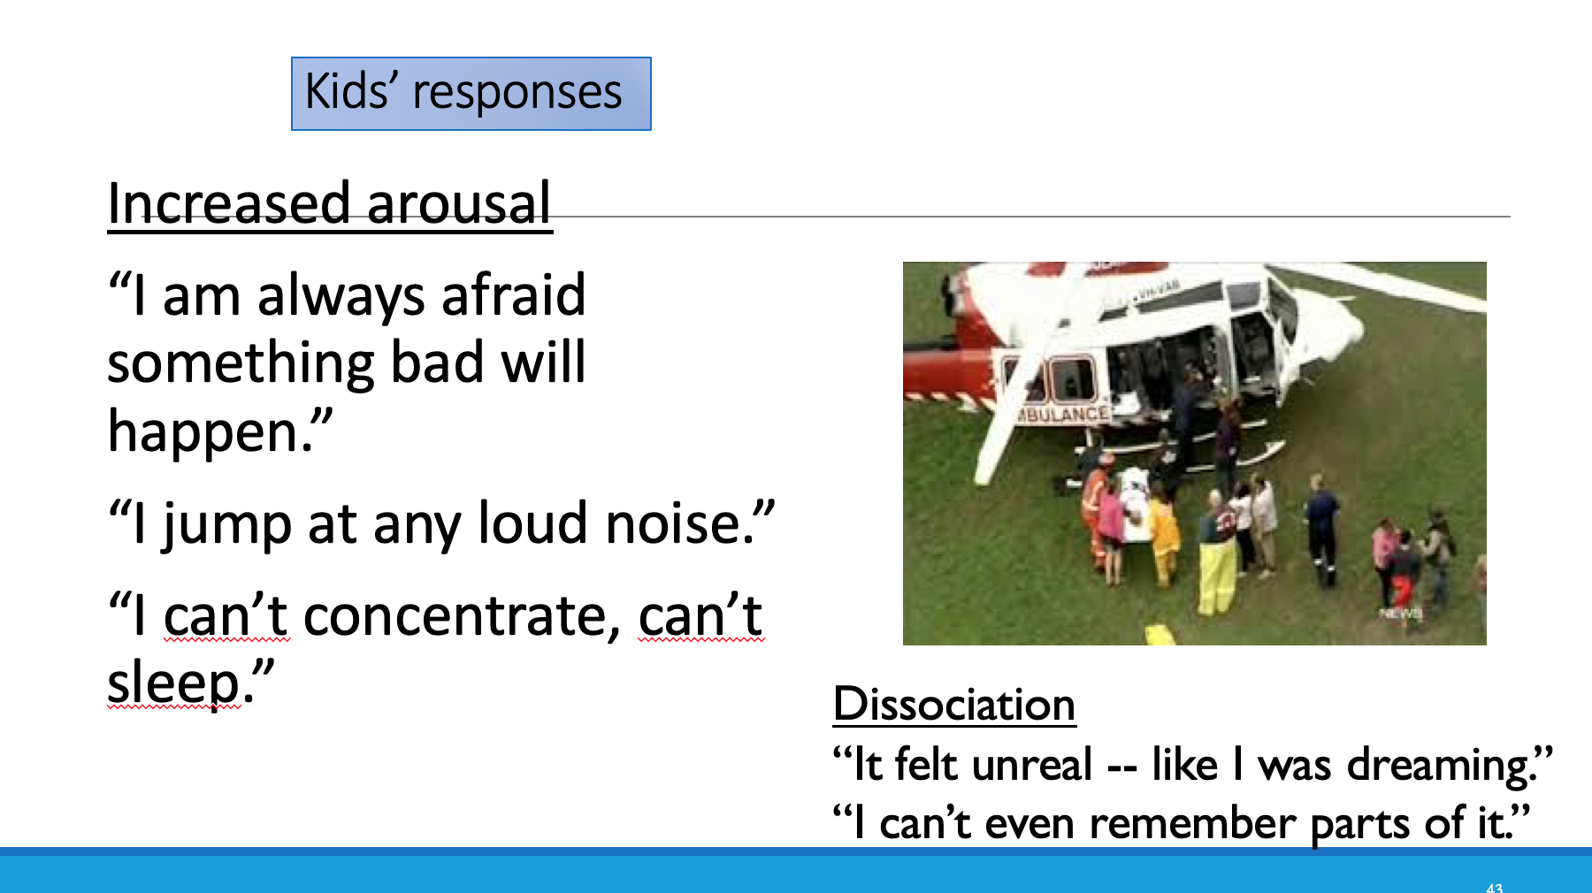
How it feels to the child

Slide 37
What Students Say After B.I.
I study for twice as long as I used to, but I’m doing much worse
I can’t remember anything I read no matter how many times I re-read the same thing
I study hard and then I take the test and can’t remember the answers
Essay questions are so hard! I need 20 minutes to think of what I need to say and then the time runs out
I’m so tired I can hardly get through the school day
I get distracted so easily

Slide 38
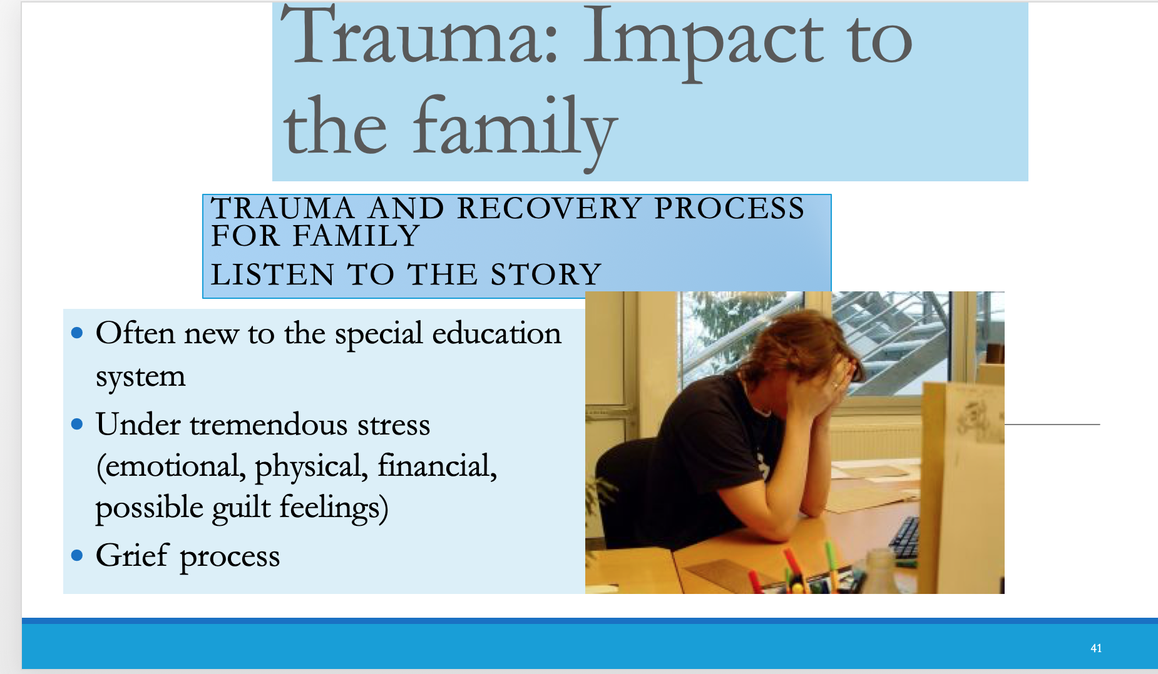

Slide 39
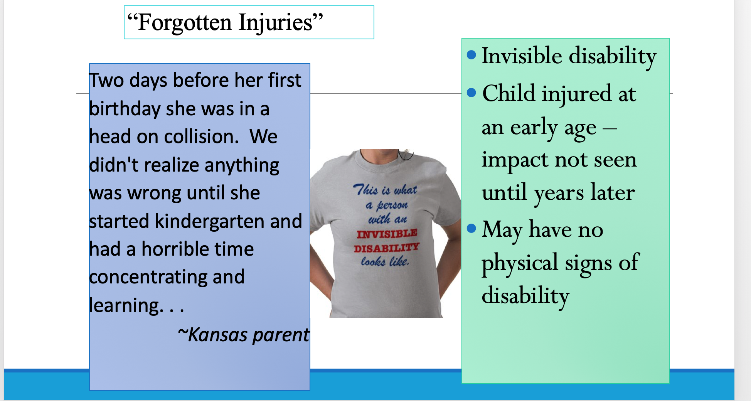

Slide 40
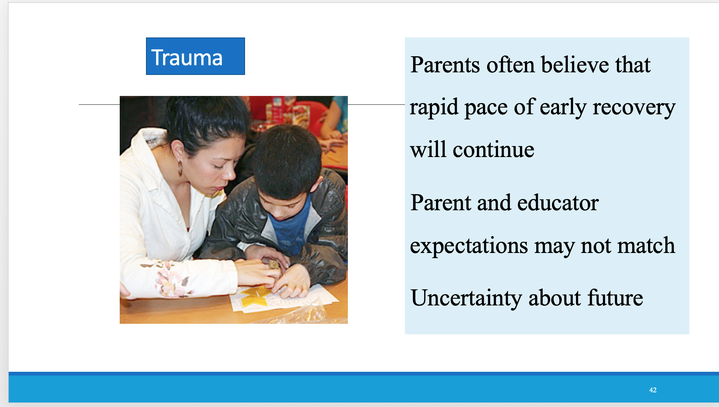

Slide 41
RETURN TO LEARN (RTL)
Goal of returning to school soon - We don’t sit at home in dark rooms for several weeks anymore
Normalization of activities - What is our New Normal?!?
Educational Accommodations - these may change often over time
Differentiated Instruction
Student goals and requirements
Teacher Education
504 or IEP/SPED Services (this is a LEGAL DOCUMENT) - it must be followed (THIS IS NOT A BUFFET TABLE!!!)

Slide 42
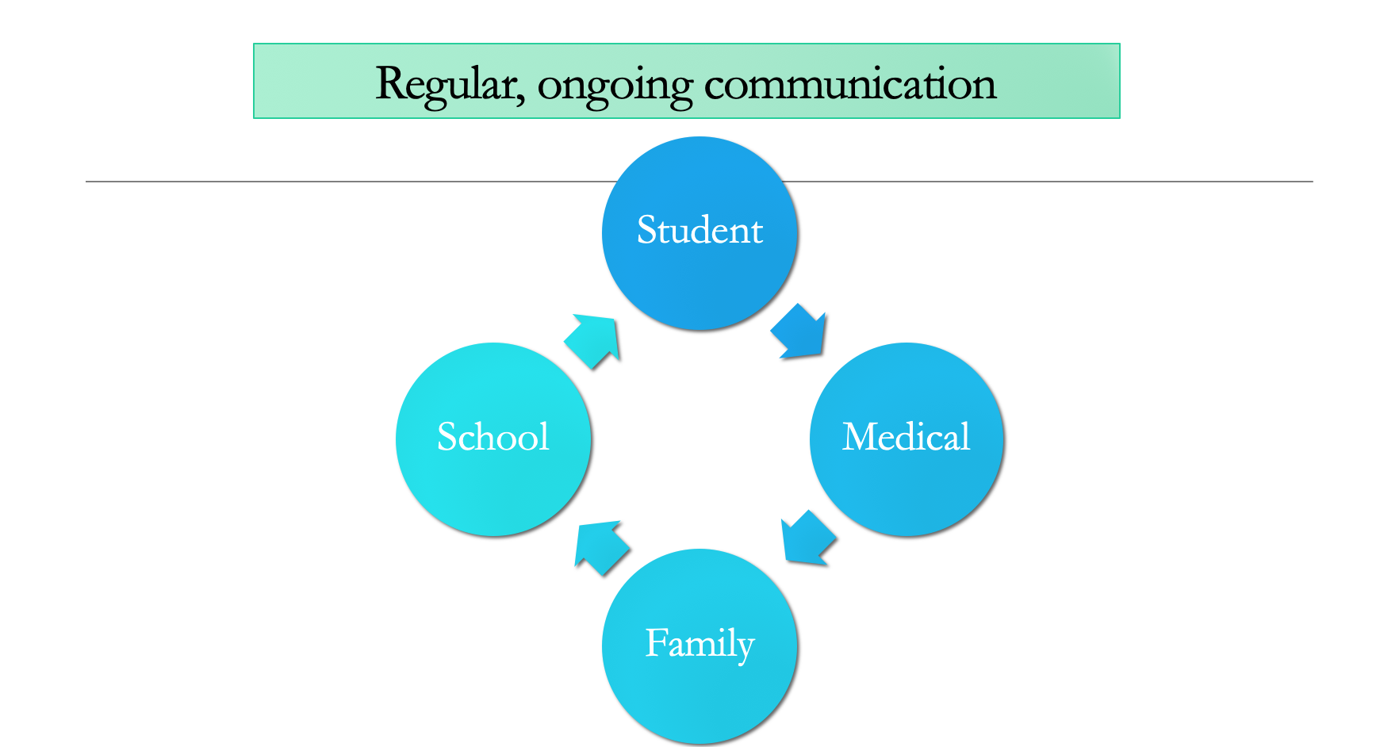

Slide 43
POST TEST
TBI is the most prevalent eligibility category in special education in Oregon. (F)
Most students diagnosed with brain injuries receive special education services. (F)
When students return to school after TBI, their level of functioning remains fairly constant over time.(F)
Specific accommodations and accommodations designated for a student rarely change in a given student’s academic career.(F)
Every student who sustains a concussion, TBI, ABI needs an IEP.(F)
All states require a medical diagnosis/medical statement documenting the injury before an IEP, 504 Plan can be initiated.(F)
Most school staff are abundantly aware of TBI.(F)
Athletes who have sustained three or more concussions are more likely to have long-term cognitive issues.(T)

Slide 44
MELANEY GRENZ, M.S,CCC-SLP
TBI Liaison for Lane County
541.513.1169
melaney.grenz@springfield.k12.or.us
https://cbirt.org/tbi-team

Slide 45
References
McAvoy,Karen, Eagan-Johnson, Brenda, Dymacek, Rosalie, Hooper, Stephen, McCart, Melissa, Tyler, Janet , Establishing Consensus for Essential Elements in Returning to Learn Following Concussion, Journal of School Health
Nagele, Drew, Hooper, Stephen, Hildebrant, Kristin, McCart, Melissa, Dettmer, Judy, Gland (2019) Under Identification of Students with Long Term Disability from Moderate to Severe TBI: Analysis of Causes and Potential Remedies,Physical Disabilities: Education and Related Services

